Slide 1




UNIVERSITY OF BASRAH / COLLEGE OF SCIENCE
LECTURE 2
NOMENCLATURE, CLASSIFICATION AND Identification
Department of Pathological Analyses
Presented by Prof.Dr. Saad S. Mahdi Al-amaradi Al-Amara

Slide 2

Classification of organism
1) Phenetic Classification
• Phenetic system -which groups organisms together based on the mutual similarity of their phenotypic characteristics.
• This classification system succeeded in bringing order to biological diversity and clarified the function of morphological structures. For example, because motility and flagella are always associated in particular microorganisms, it is reasonable to suppose that flagella are involved in at least some types of motility.
• Although phenetic studies can reveal possible evolutionary relationships, they are not dependent on phylogenetic analysis.
• The best phenetic classification is one constructed by comparing as many attributes as possible. Organisms sharing many characteristics make up a single group or taxon.

Slide 3
Classification of organism
2) Phylogenetic Classification
• Phylogeny (Greek: Phylum-tribe or race and gene is genera or origin) is refers to evolutionary development of a species.
• Phylogenetic classification : classified organism on the basis of evolutionary relationship.
• At the end of 20 th century, woose was able to assess evolutionary relationship between microbes causing nucleotide sequence.
• Currently over 2,00,000 different 16S and 18S rRNA sequence are available.
3) Genotypic Classification
• Organism are classified on the basis of genetic similarities.
• Individual gene or whole gene can be compared.

Slide 4
Classification of organism
4) Numerical Taxonomy
• Peter H. A. Sneath and Robert Sokal have defined numerical taxonomy as “the grouping by numerical methods of taxonomic units into taxa on the basis of their character states.”
• Information about the properties of organism is converted into a form suitable for numerical analysis and then compared by means of computer.
• Process begins with determination of presence or absence of selected character in a group of organism under study.
• Many characters at least 50, preferably >100 should be compared for an accurate and reliable classification of organism. Characters used are:
1. Morphological character, 2. Chemical character, 3.Cultural character
4. Metabolic character, 5. Antigenic character , 6.Biochemical character
7. Physiological character , 8. Ecological character

Slide 5
Technique used for determining microbial taxonomy and phylogeny
• Classical methods • Molecular methods
Classical methods
1. Morphological characteristics
2. Physiological characteristics
3. Biochemical characteristics
4. Ecological characteristics
5. Genetic characteristics

Slide 6
Classification of organism
1) Morphological characteristics
• Important in microbial taxonomy.
• Easy to study and analyze particularly in eukaryotic microorganism and more complex prokaryotes.
• Morphological similarity is often a good indication of phylogenetic relatedness.
• Morphological characters are used in the classification and dentification of microorganism
• Light microscopy is an important tool.
• The transmission and scanning electron has greater importance to visualize all microbes.

Slide 7
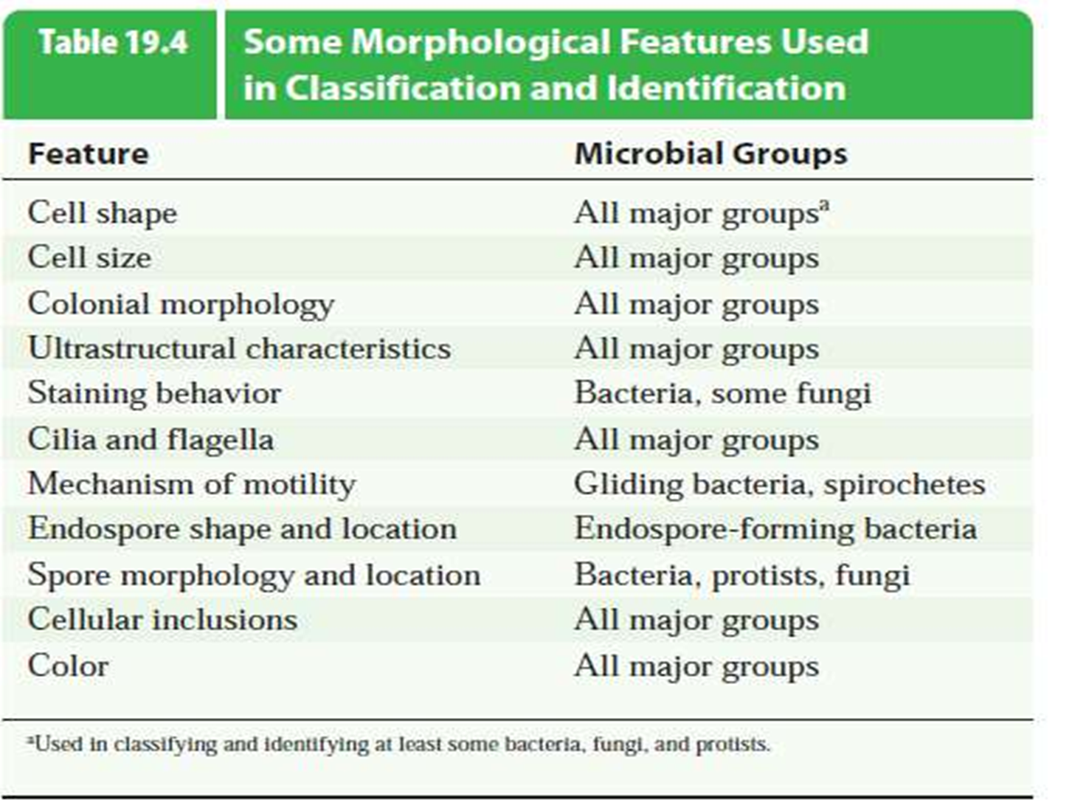
Classification of organism

Slide 8
Classification of organism
2) Physiological and metabolic character
• Are very useful because they are related to the nature and activity of microbial enzymes and transport proteins.
• Proteins are gene product, analysis of these characteristics provides an indirect comparison of microbial genomes.

Slide 9
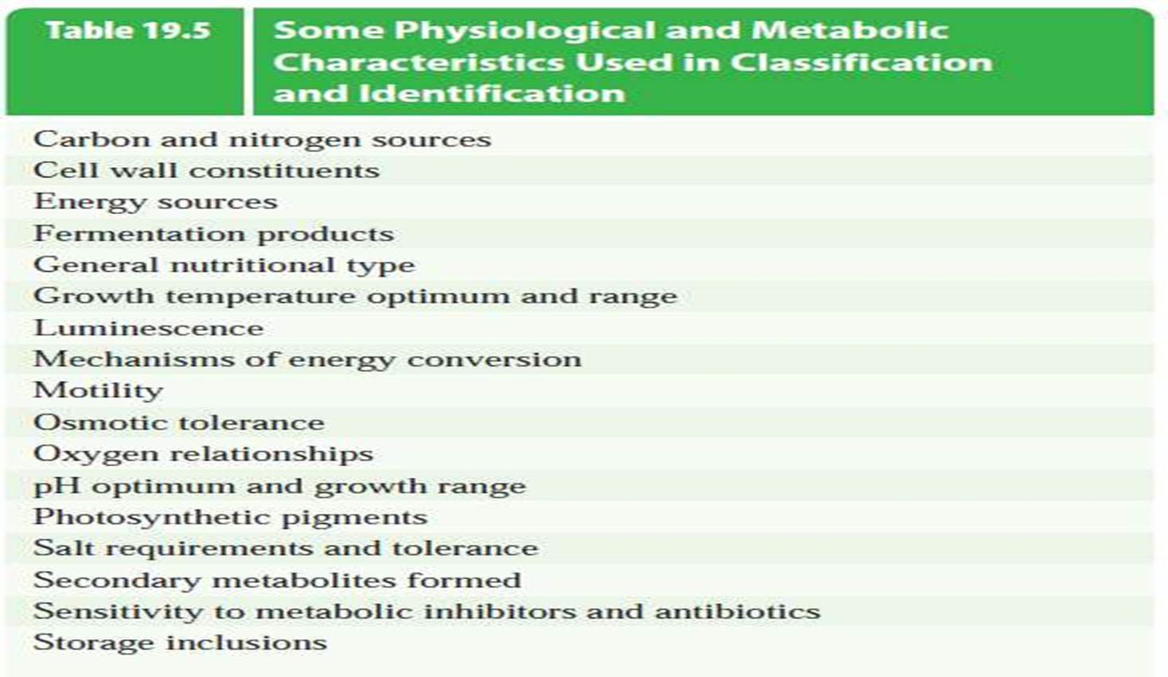
Classification of organism

Slide 10
Classification of organism
3) Ecological characteristics
• Habitat and distribution of organism in nature and interaction between and among species in natural environment.
• Microorganism found in marine environment differ from those found in fresh water.
• The microbial population of oral cavity differ from the intestinal tract

Slide 11
Classification of organism
4) Biochemical characteristics
• Presence or absence of specific enzymes in microorganisms.
• Constituents of the cells such of cell wall lipid or amino acid content, membrane protein content or presence of specific pigments etc.
5) Genetic characteristics
• Characteristics of hereditary material of cell (DNA and RNA).
• The sequence of nucleotide bases in the DNA etc.
• DNA base composition
• Occurrence and function of other kinds of extrachromosal genetic material such as plasmid.
• Chromosomal gene exchange through transformation, conjugation and transduction.

Slide 12
Classification of organism
2. Molecular methods
• Analysis of nucleic acid (DNA and RNA) and protein.
• Phylogenetic inference based on molecularcharacteristics provide the most strong and reliable analysis of microbial evolution.
• Molecular method used in classification andidentification of microbes are;
a) Nucleic-acid base composition
b) Nucleic-acid hybridization
c) Nucleic-acid sequencing
d) Genome fingerprinting
e) Amino acid sequencing

Slide 13
﻿THANK YOU

